Slide 1
The Seed of the Woman vs
The Dragon
Genesis 3, Revelation 12
W. Cochran
wayne.cochran@gmail.com
Notes:
Revelation is a bookend with Genesis / OT.
Matthew opens with genealogy of Jesus son of David, son of Abraham,
Who are David and Abraham? Are they important? Two of the biggest names in OT!
Why is Moses left out? Important.
David appears in last chapter of NT. Jesus is not just the descendent — he is The Root of David (Revelation 22:16).
Answers Jesus’ riddle to the scribes in Matthew 22:42 concerning Psalm 110:1.

Slide 2
Enmity Between The Serpent and The Woman
Genesis 3
Genesis 3:1-7 : The Serpent = Dragon = the devil (slanderer) and Satan (accuser) (Revelation 12:9, 20:2)
“Deceiver of whole world” (Revelation 12:9) deceives the woman Eve and man falls.
Genesis 3:15 : Protoevangelium —foreshadows Satan’s ultimate defeat (crushed head) by “her seed.” Romans 16:20, Hebrews 2:14,
Genesis 3:16 — Woman’s curse: pain of childbirth and subjugation to husband.
Genesis 4:1 — Does Eve expect Cain to be the one to crush the serpent’s head?
Revelation 12 : Same battle from a cosmic perspective reaches its climax.
Notes:
Allusion to virgin birth?
Typically “the seed” is supplied by the male (Abraham Genesis 12:7, 13:6; Galations 3:16,16), but the child comes “the seed” of the woman.
Historically woman have frequently had to bear the burden of childbirth often died (and/or their child) under horrific conditions.
https://ourworldindata.org/child-mortality
Often women have had oppressive husbands who dictated perpetual pregnancies.
Pain may be more from raising and protecting child in cruel world.
Simeon’s message to Mary “a sword will pierce through your own soul” Luke 2:35,
Eve “saved” through childbearing 1 Timothy 3:15.

Slide 3
Protoevangelium
I will put enmity between you [Serpent] and the woman,
and between your offspring and her offspring;
he shall bruise your head,
and you shall bruise his heel.
Genesis 3:15

Slide 4
Revelation 12 in Context of The Great Tribulation
Revelation 11 : Seventh Trumpet
  The Great Tribulation (Matthew 24:15-22), “Jacob’s trouble” (Jeremiah 30:7)
  The Victor (11:15) : The Heir receives His inheritance
Revelation 12 - 13 : Satanic Trinity
  The Great Red Dragon (12)
  The Beast out of the sea (13:1 - 13:10)
  The Beast out of the earth (The False Prophet, 13:11-18)
Revelation 15, 16 : Seven Bowls of God’s Wrath
Notes:
Tribulation : Daniel 12:1, Day of The Lord (Isaiah 13:6-9), Jacob’s (Israel)’s Trouble (Jeremiah 30:7; Daniel 12:1)
Last 3 1/2 years is tribulation for Israel (Jacob, “thy people” - Dan 12:1), where they will be protected and delivered
Last half of Daniel’s 70th week which concerns “they people” = Israel
After war in heaven, Satan and his demons cast to earth (Luke 10:18?)
Tribulation lasts 7 years (1 week, Daniel 9)
Great Tribulation: Last Half = 3 1/2 Years: 42 Months (11:2), “times, times, and half a time” (Daniel 7:25, 12:7, Rev 12:14), “half a week” (Daniel 9:26), 1260 days (11:3, 12:6)
Max fury from God and Satan.

Slide 5
Main Characters of Revelation 12
The Woman | Israel (Genesis 37:9)
Great Red Dragon | Satan (12:9, 20:2)
Male Child | Christ
Michael | Archangel, Prince of Israel (Daniel 12:1)

Slide 6
Main Characters of Revelation 12, 13
The Woman | Michael
Great Red Dragon | Beast out of the sea
Male Child | Beast out of the earth
Notes:
The Woman, The Serpent (Dragon), and the Woman’s Seed (Male Child) are the same character’s from Genesis 3 which describes the Fall of man and alludes to the future defeat of Satan.

Slide 7
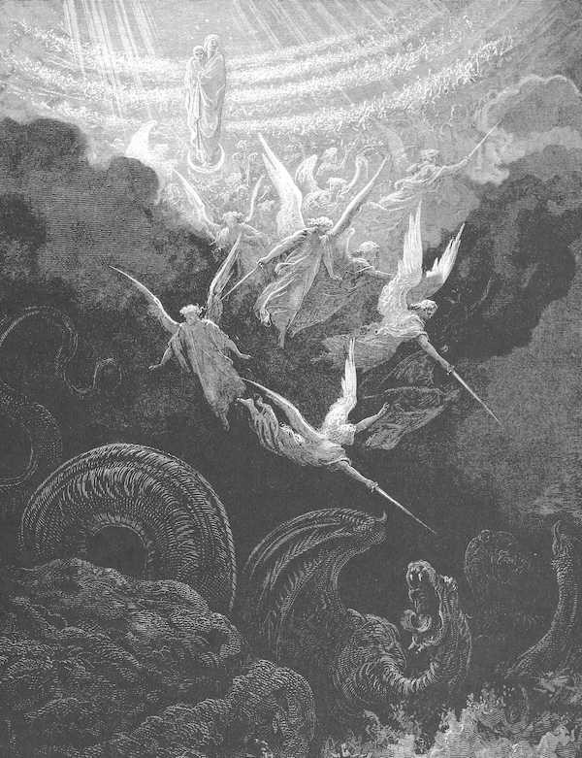
The Woman
Revelation 12:1-2
“a great sign appeared” (v. 1) : a symbolic vision typical of prophecy
Joseph’s Dream : Genesis 37:5-11
Woman is Israel though whom would come the Christ
  Birth pains (Matt 24:8) of Second Advent (Isaiah 26:17-21; 66:7)
  Pursued by Satan
  Protected by God during the Great Tribulation (12:6,14; Jeremiah 30:6,7)

Slide 8
The Great Red Dragon
Revelation 12:3,4
Identity of Dragon in Revelation 12:9, 20:2
7 heads, 10 horns, 7 crowns
  Beast out of the sea (Revelation 13:1)
    Conglomerate of Four Beasts of Daniel 7.
  Identified in Revelation 17:9-14
Fallen Angel (Ezekiel:14-18; Isaiah 14:12-14)
  Drags 1/3 of angels with him (Revelation 12:4)

Slide 9
The Male Child
Revelation 12:4-6
Identity : “one who is to rule all the nations with a rod of iron” (v. 5. Psalm 2, Revelation 2:27, 19:15).
Satan seeks to devour the child
  Pharaoh (Exodus 1:15,16) ; Haman (Esther 3:5,6); Herod the Great (Matthew 2:16); Antiochus IV Epiphanes, Hitler, …
Satan has Christ executed to his own demise (Colossians 2:15)
  Christ’s ascension: “her child was caught up to God and to his throne”
    He “set down at the right hand of the throne of God” (Acts 1:9, Hebrews 1:3, 12:2)
Woman flees to a place to nourished by God for 3 1/2 years.
  “flee to the mountains” Matthew 24:15-22.
Notes:
https://en.wikipedia.org/wiki/Timeline_of_antisemitism

Slide 10
War in Heaven
Revelation 12:7-12
Michael vs Satan
  Daniel 12 — “time of the end” — 3.5 years in 12:7
  Jude 9 — Michael the Archangel fighting with Devil over the Body of Moses.
Satan defeated : he and his angels are thrown down to earth.
  Conquered “by the blood of the Lamb.”
  Full wrath of Satan as The Great Tribulation begins
    Satan knows his time is short.
Notes:
Satan is not presently in Hell and will be the lowest creature there when cast into the Lake of Fire.
Fallen Cherub — still has access to Heaven — will be cast out of Heaven to Earth.
John 12:31, Heb 2:14, Col 2:14— ruler of this world has been “cast out,” “destroyed” and “defeated” at the cross, but he is still awaiting his execution.
Michael fought Prince of Persia — Daniel 10:13.
1 Thess 4 — archangel blows the trumpet

Slide 11
Wrath of Satan
Revelation 12:13-17
The Great Tribulation: Time of Jacob’s Trouble (Jeremiah 30:7, Matthew 24:21; Daniel 12)
The Dragon pursues the woman (Israel),
  Woman flies into the wilderness (Exodus 19:4).
Dragon tries to “sweep her away with a flood.” (Psalm 124)
Notes:
Matthew 25 : Sheep: Gentiles that help Israel.
Revelation 13 : those who don’t have the mark of the beast will not be able to buy or sell.
The horn prevailed over the saints Daniel 7:13
Flood “figurative” of an army?
Earth opened up and swallowed those who were part of Korah’s rebellion (Numbers 16:31)
Earthquake? Revelation 6

