Slide 1
Biblical Worship
Making the Most of God’s Resources for Your Growth

Slide 2
Biblical Worship
What is worship?
How important is worship?
How should we worship?

Slide 3
What is Biblical Worship?
?

Slide 4
Genesis 22:1-5
After these things God tested Abraham and said to him, “Abraham!” And he said, “Here I am.” ² He said, “Take your son, your only son Isaac, whom you love, and go to the land of Moriah, and offer him there as a burnt offering on one of the mountains of which I shall tell you.” ³ So Abraham rose early in the morning, saddled his donkey, and took two of his young men with him, and his son Isaac. And he cut the wood for the burnt offering and arose and went to the place of which God had told him. ⁴ On the third day Abraham lifted up his eyes and saw the place from afar. ⁵ Then Abraham said to his young men, “Stay here with the donkey; I and the boy will go over there and worship and come again to you.”

Slide 5
Exodus 3:1-12 & Deuteronomy 12:1-7

Slide 6
Hosea 6:6 & Psalm 40:6-8

Slide 7
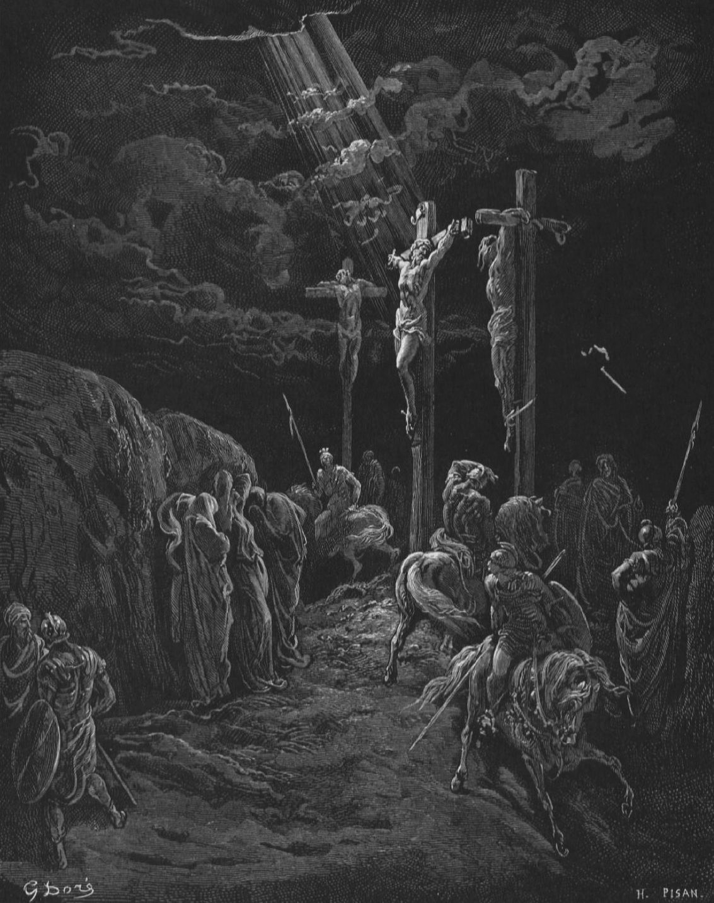
THIS IS WORSHIP

Slide 8
What is worship?
Worship involves
Sacrifice
Submission
Giving thanks
Giving glory
Praising
Obedience
Trust
Etc…

Slide 9
How important is worship?
There is no aspect of Christian faith that does not involve worship

Slide 10
How do we worship?
John 4:1-26

