Slide 1
Return of Rule of Christ Daniel 1-4
W. Cochran

Slide 2
Old Testament Timeline
First Temple
957
First Temple
Destroyed
586
Exodus
Kings
Canaan
Egypt
Judges
722
586
Moses
Alexander
2000 BC
1000 BC
Babylon
Greece
Abraham
David
Medes
Persians
Assyria
Rome

Slide 3
Daniel Initial Timeline
612 : Assyrian capital Nineveh overrun by Babylonians.
609 : King Josiah killed by Egyptians in Battle of Megiddo (2 Kings 23:28-30).
Egyptians install Jehoiakim as king (2 Kings 23:34-36).
605 : Battle of Carchemish : Assyrians allied with Egyptians were defeated by Nebuchadnezzar II’s army.
597 : Siege of Jerusalem. First deportation of Jews (2 Kings 24)
Zedekiah installed as tributary king but revolts and joins alliance with Egypt.
589-586 : Siege of Jerusalem. Destruction of temple and city (2 Kings 25)
Zedekiah was blinded, bound, and taken captive to Babylon where he remained as prisoner until his death (2 Kings 25:7; Jeremiah 52:10,11).
The elite were taken into Captivity in Babylon

Slide 4
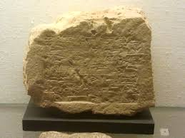
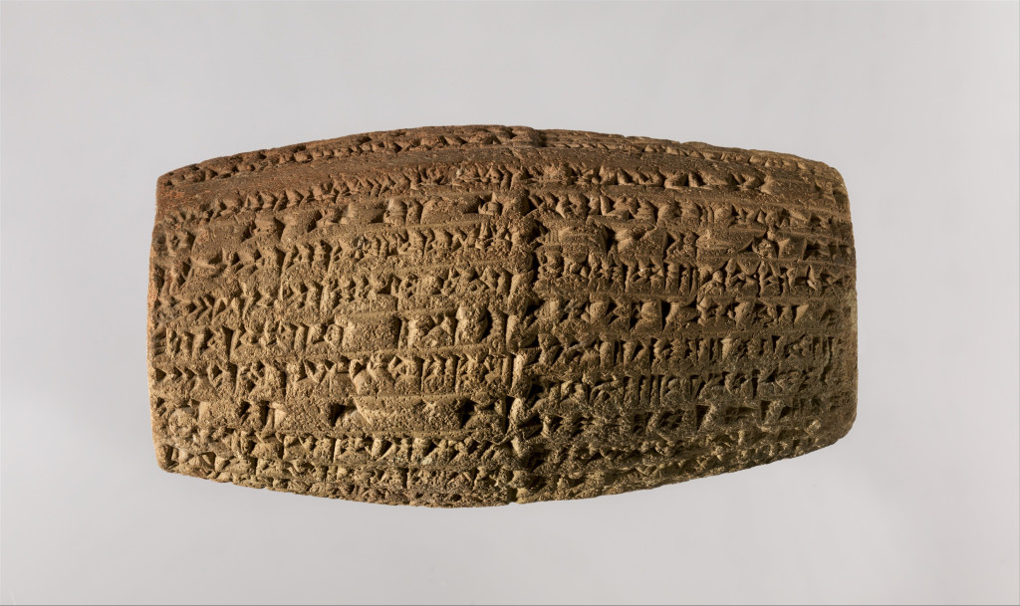
Pride of Nebuchadnezzar
Nebuchadnezzar had his name repeatedly
pressed into the bricks of the city of Babylon
he had rebuilt, so his bricks are a common
sight in history museums around the world.
“Is not this great Babylon, which I have built by my mighty power as a royal residence and for the glory of my majesty?” Daniel 4:30
“I built a strong wall that cannot be shaken with bitumen and baked bricks… I laid its foundation on the breast of the netherworld, and I built its top as high as a mountain… The fortifications of Esagila and Babylon I strengthened and established the name of my reign forever.”
Cuneiform cylinder with inscription of Nebuchadnezzar describing the construction of the outer wall.

Slide 5
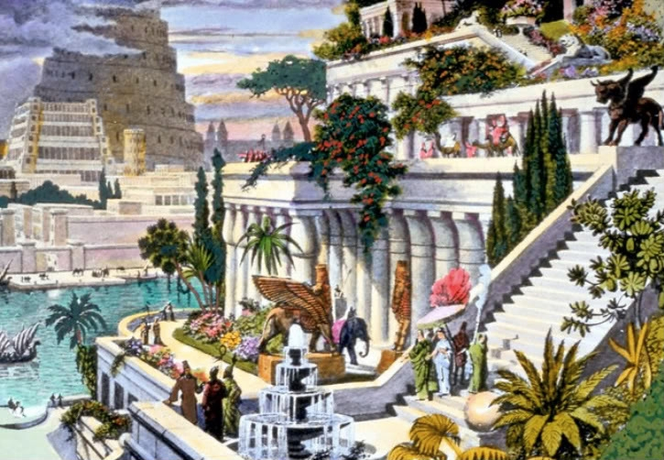
Hanging Gardens of Babylon
Notes:
“In this palace he erected very high walks, supported by stone pillars; and by planting what was called a pensile paradise, and replenishing it with all sorts of trees, he rendered the prospect an exact resemblance of a mountainous country. This he did to gratify his queen, because she had been brought up in Media, and was fond of a mountainous situation.” Josephus quoting Berossus, a Babylonian priest of Marduk, whose writing circa 290 BC is the earliest known mention of the gardens.

Slide 6
Chronology of
The Book of Daniel
Jeremiah
70 Years (Jeremiah 25:8-14)
70 = 490/7 years of Sabbaths for the land (2 Chronicles 36:21)
Darius
(Medes)
Nebuchadnezzar
Evil-Merodach
…
Belshazzar
Cyrus
(Persians)
586
539
605
first
deportation
562
553
535
return under
Zerubbabel
Ezekiel
553 BC
Four Beasts
Little Horn
Ancient of Days
(Ch 7)
585 BC
Fall of Tyre
605 BC
Daniel refuses
delicacies
(Ch 1)
538-534 BC
Lion’s Den
(Ch 6)
587 BC
Golden Image
Fiery Furnace
(Ch 3)
571-562 BC
Nebuchadnezzar’s
judgment
(Ch 4)
551 BC
Ram & Goat
(Ch 8)
603 BC
Great Statue
(Ch 2)
539 BC
Writing on Wall
70 Weeks
(Ch 5, 9)
~534
Kings N/S
Time of End
(Ch 10-12)

Slide 7
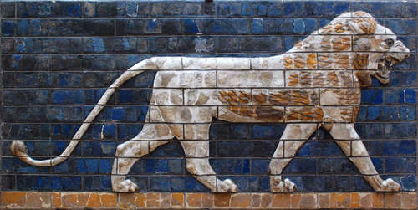
Daniel Exiled to Babylon
Daniel 1
606-605 BC Third Year of Jehoiakim (607-598), son of Josiah
Nebuchadnezzar II “A lion .. destroyer of nations” Jeremiah 4:7
“But Daniel resolved that he would not defile himself..” (v 8)
Lion of Babylon, Ishtar Gate
Notes:
Lion of Babylon, Ishtar gate

Slide 8
Chiasmus of Daniel 2 - 7
Daniel 2:4b-7:28 is written in Aramaic not Hebrew
A : Dream of four kingdoms replaced by a fifth (Ch 2)
B : Daniel’s three friends in fiery furnace (Ch 3)
C : Daniel’s interpretation of dream for Nebuchadnezzar (Ch 4)
C : Daniel’s interpretation of handwriting on wall for Belshazzar (Ch 5)
B : Daniel in the Lion’s Den (Ch 6)
A : Vision of four kingdoms replaced by a fifth (Ch 7)

Slide 9
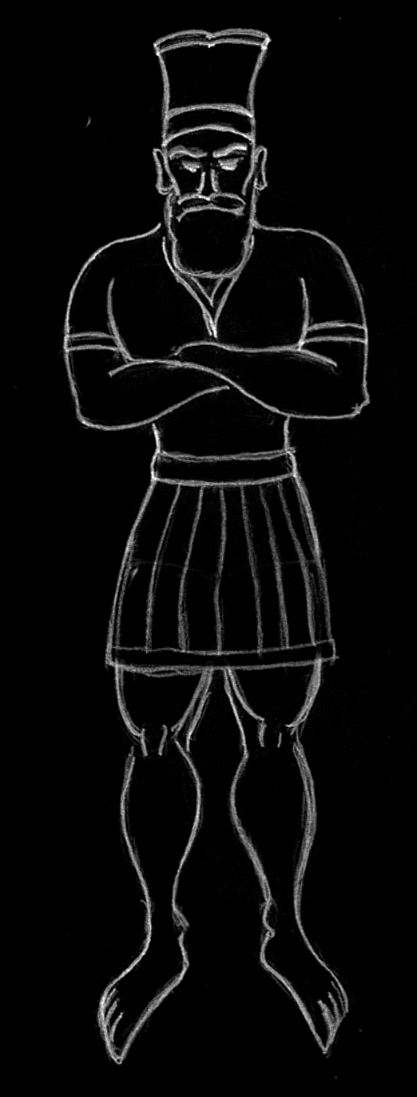
Nebuchadnezzar’s Dream
Daniel 2
GOLD
Nebuchadnezzar
Babylon
SILVER
Media
Persia
As with Joseph, God reveals to Daniel the meaning of the king’s dreams.
Dream foretells of five kingdoms
Babylon (Nebuchadnezzar Daniel 2:37,38)
Media / Persia
Greece
Rome (which becomes divided)
Millennial / Eternal Kingdom
Bronze
Greece
Iron
Rome
Iron & Clay
Notes:
Daniel 2 - 7 also forms a chiasmus
A : dream of 4 kingdoms replaced by a fifth (Ch 2)
B : Daniel’s 3 friends in fiery furnace (Ch 3)
C : Daniel’s interpretation of dream for Nebuchadnezzar (Ch 4)
C : Daniel’s interpretation of handwriting on wall for Belshazzar (Ch 5)
B : Daniel in the Lion’s Den (Ch 6)
A : A vision for 4 kingdoms replaces by a fifth (Ch 7)

Slide 10
Millennial Kingdom
As you looked, a stone was cut out by no human hand, and it struck the image on its feet of iron and clay, and broke them in pieces. Then the iron, the clay, the bronze, the silver, and the gold, all together were broken in pieces, and became like the chaff of the summer threshing floors; and the wind carried them away, so that not a trace of them could be found. But the stone that struck the image became a great mountain and filled the whole earth.
Daniel 2:34,35
And in the days of those kings the God of heaven will set up a kingdom that shall never be destroyed, nor shall the kingdom be left to another people. It shall break in pieces all these kingdoms and bring them to an end, and it shall stand forever
Daniel 2:44

Slide 11
Nebuchadnezzar’s
Golden Image
Daniel 3
Nebuchadnezzar Golden Image is mimicked by The False Prophet in Revelation 13:14-18.
And it was allowed to give breath to the image of the beast, so that the image of the beast might even speak and might cause those who would not worship the image of the beast to be slain.
Revelation 13:15
Shadrach, Meshach, and Abednego were willing to pay the price even if God would not deliver them.

Slide 12
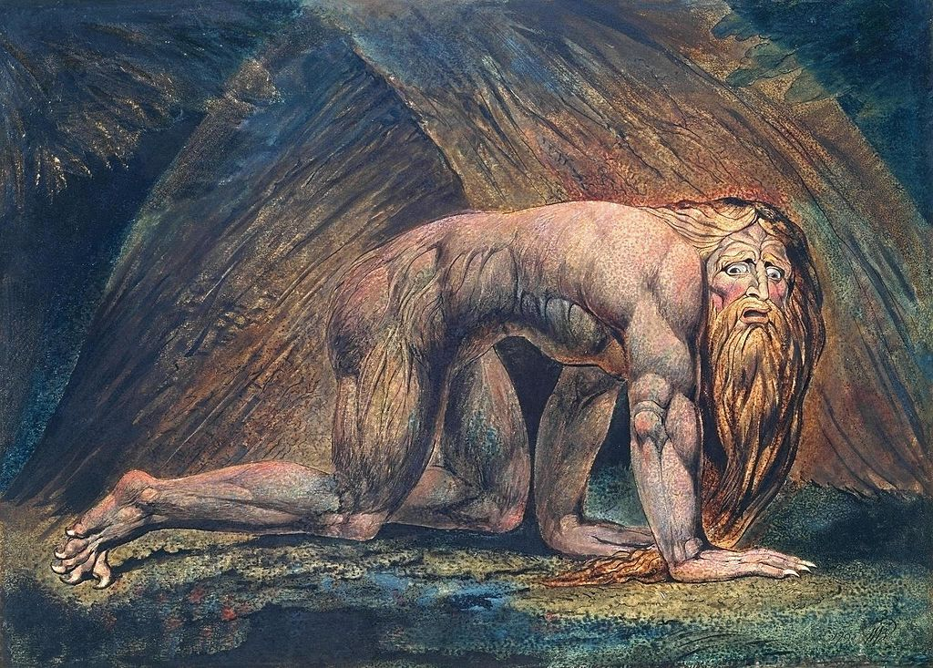
Humbling of Nebuchadnezzar
Daniel 4
Notes:
4:4 Is in the first person written by Nebuchadnezzar.

Slide 13
Nebuchadnezzar Restored
Daniel 4:34-37
“..for his dominion is an everlasting dominion,
and his kingdom endures from generation to generation;
all the inhabitants of the earth are accounted as nothing,
and he does according to his will among the host of heaven
and among the inhabitants of the earth;
and none can stay his hand
or say to him, “What have you done?”
Nebuchadnezzar : Daniel 4:35

